Slide 1
Kinsmen Barbershop
Website & Booking System
INSY7315 WIL, Part 2 · Built by Kaehil, Kyra, Zario and Gregory · BCA3, IIE Emeris
kinsmen-web.onrender.com
KINSMEN · INSY7315 WIL · PART 2
01
Notes:
This is Kinsmen Barbershop's website and booking system, built for Part 2 of our INSY7315 Work Integrated Learning module. The team — Kaehil, Kyra, Zario and Gregory — developed this as BCA3 students at IIE Emeris. The system is live right now at kinsmen-web.onrender.com, and we'll walk through what it does, how it was built, and how it was tested.
[Presenter: Kaehil]

Slide 2
PROJECT OVERVIEW
The problem and the solution
01
Kinsmen Barbers needed online booking, staff scheduling and catalogue management.
02
Part 1 was a single-file HTML prototype; Part 2 is a working, hosted system.
03
Three roles: Customer, Barber, Admin.
Customer
Barber
Admin
KINSMEN · INSY7315 WIL · PART 2
02
Notes:
Kinsmen Barbers came to us needing a way to manage online bookings, staff scheduling and their service/product catalogue. In Part 1 of this project we delivered a single-file HTML prototype to validate the concept. For Part 2, we've turned that prototype into a fully working, hosted system. The system supports three distinct roles — Customer, Barber and Admin — each with their own experience, which we'll show you now.
[Presenter: Kaehil]

Slide 3
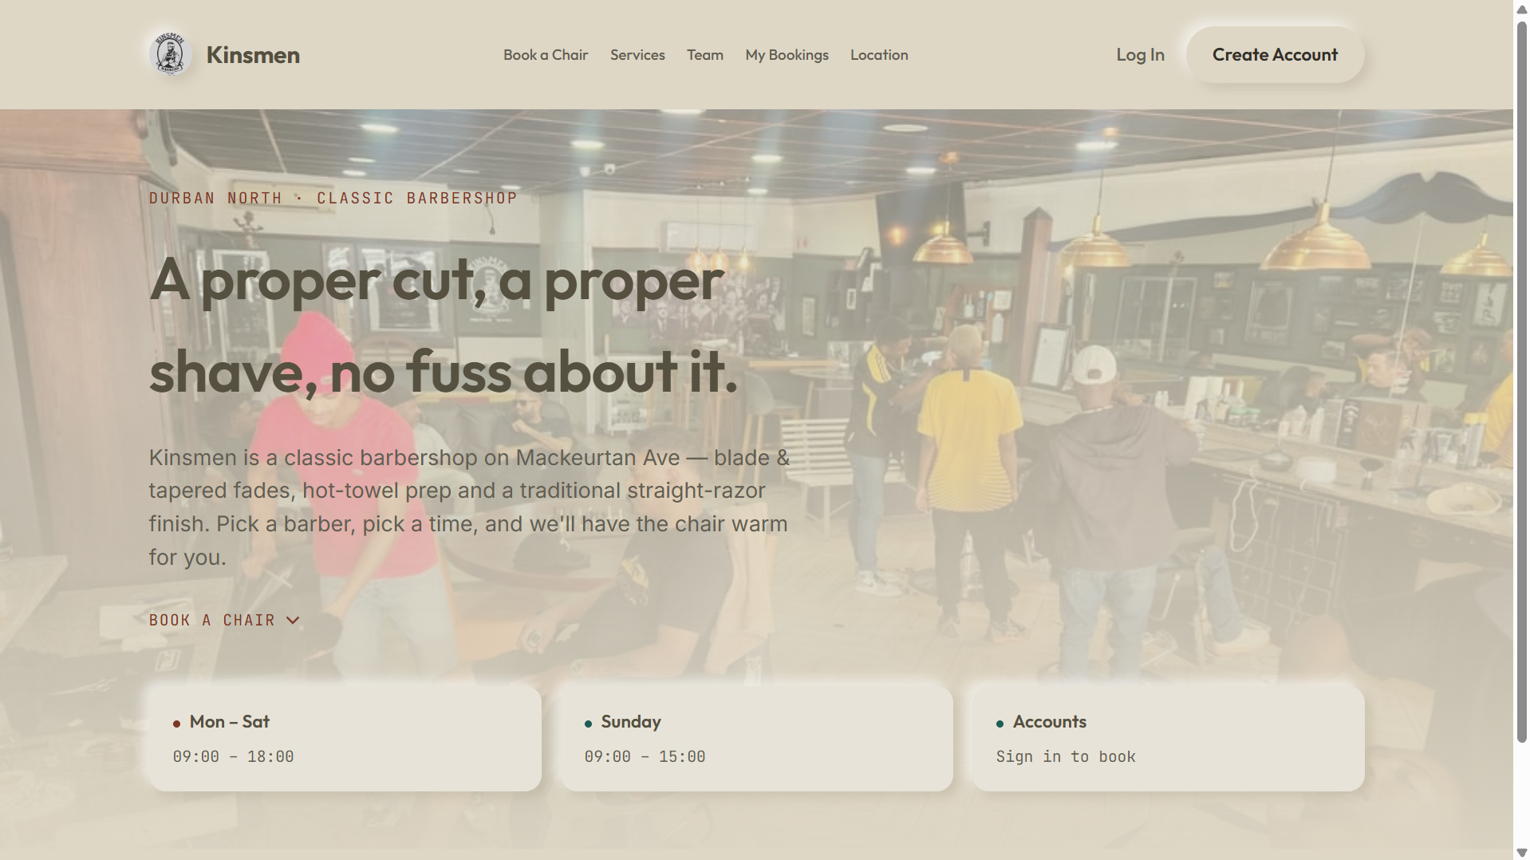
IT'S LIVE
Live system
01
Web app: kinsmen-web.onrender.com
API: kinsmen-api.onrender.com
02
Source: github.com/Kaehil-I/kinsmen-barbershop
Runs on Render's free tier — first load after idle can take up to a minute.
KINSMEN · INSY7315 WIL · PART 2
03
Notes:
The system is live in two parts: the web app at kinsmen-web.onrender.com, and a separate API at kinsmen-api.onrender.com. All source code is public on GitHub at github.com/Kaehil-I/kinsmen-barbershop. We're hosting on Render's free tier, so if the site has been idle, the very first load can take up to a minute to wake up — that's expected behaviour, not a bug.
[Presenter: Kaehil]

Slide 4
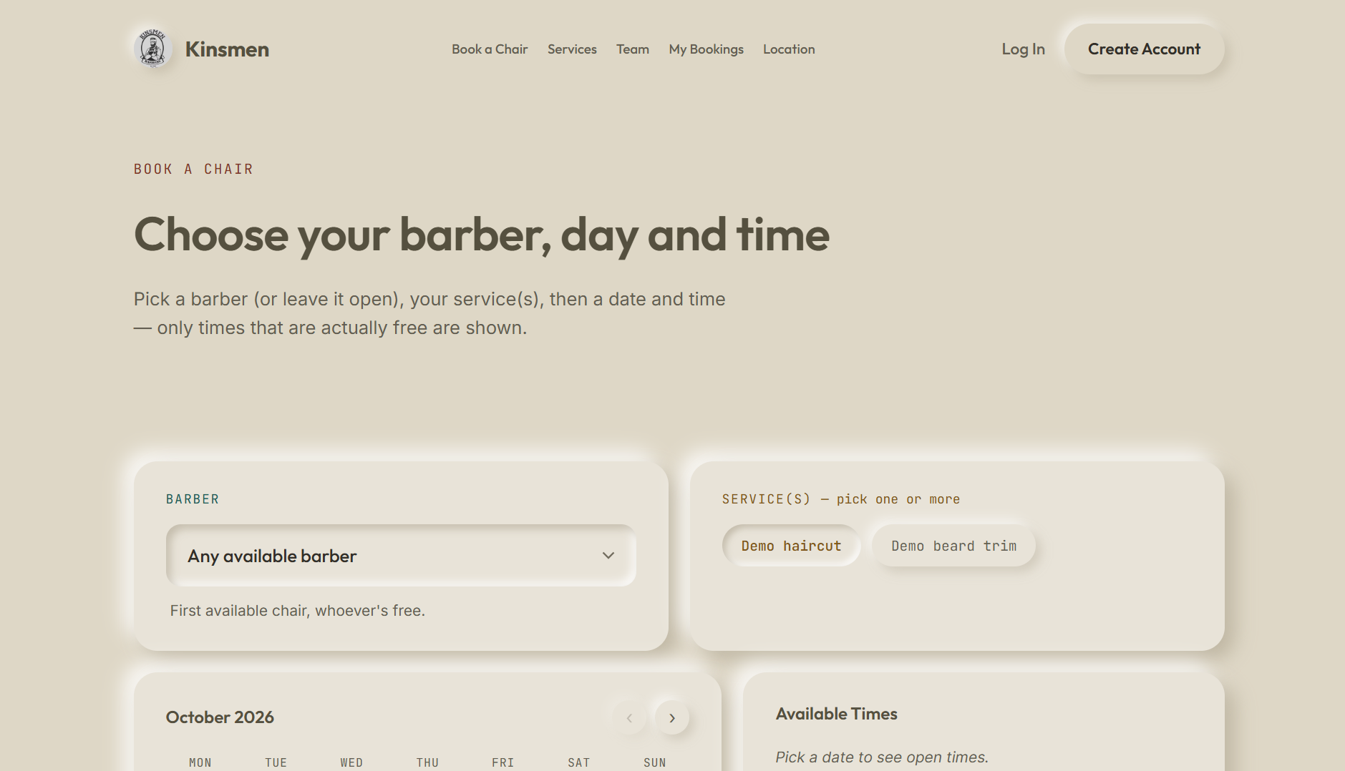
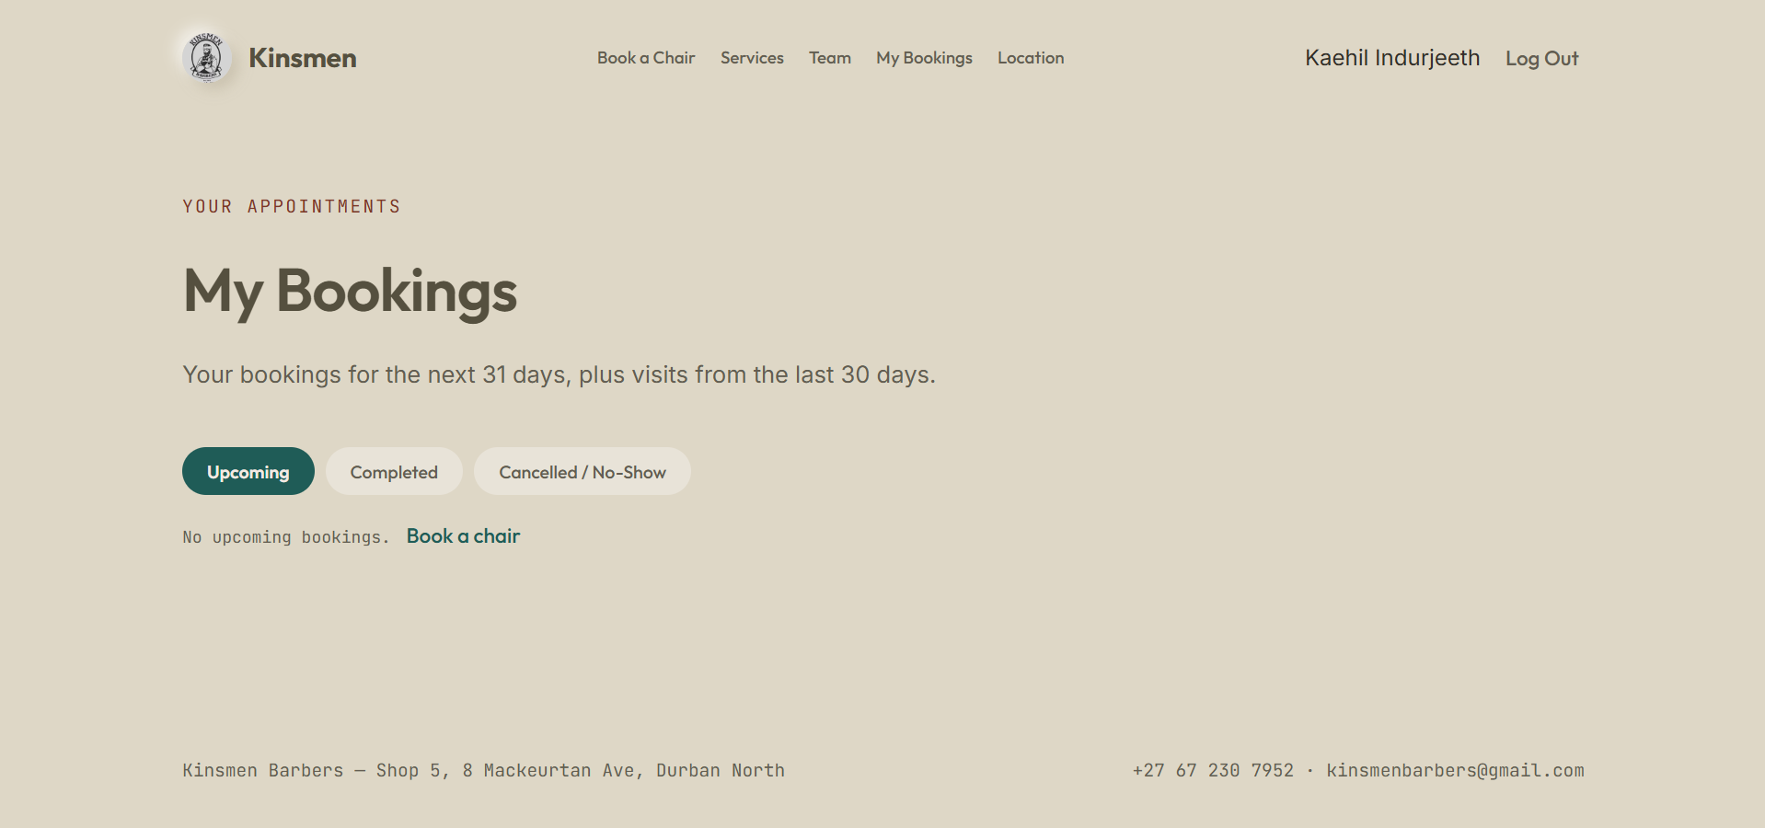
CUSTOMER EXPERIENCE
Booking, from start to finish
01
Sign up / log in (Auth0), browse services and barbers.
02
Book one or more services with a chosen barber or “any available barber”.
03
View, reschedule, cancel bookings; review a completed visit.
04
Email confirmations: booking received, confirmed, completed.
KINSMEN · INSY7315 WIL · PART 2
04
Notes:
Customers sign up and log in through Auth0, then browse our services and barbers. They can book one or more services at once, either with a specific barber or by choosing 'any available barber'. From their account, customers can view, reschedule or cancel their bookings, and leave a review once a visit is completed. At each stage — booking received, confirmed, and completed — the customer gets an email confirmation.
[Presenter: Gregory]

Slide 5
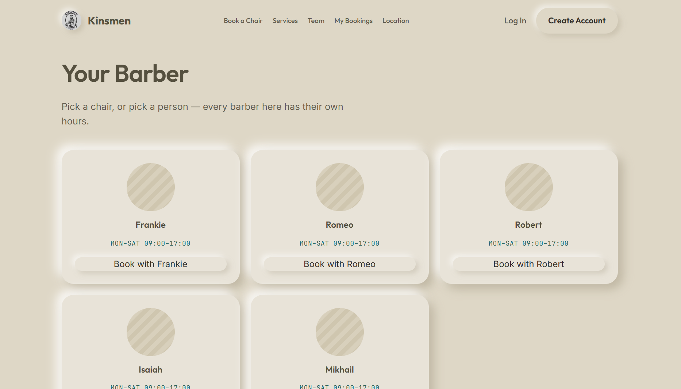
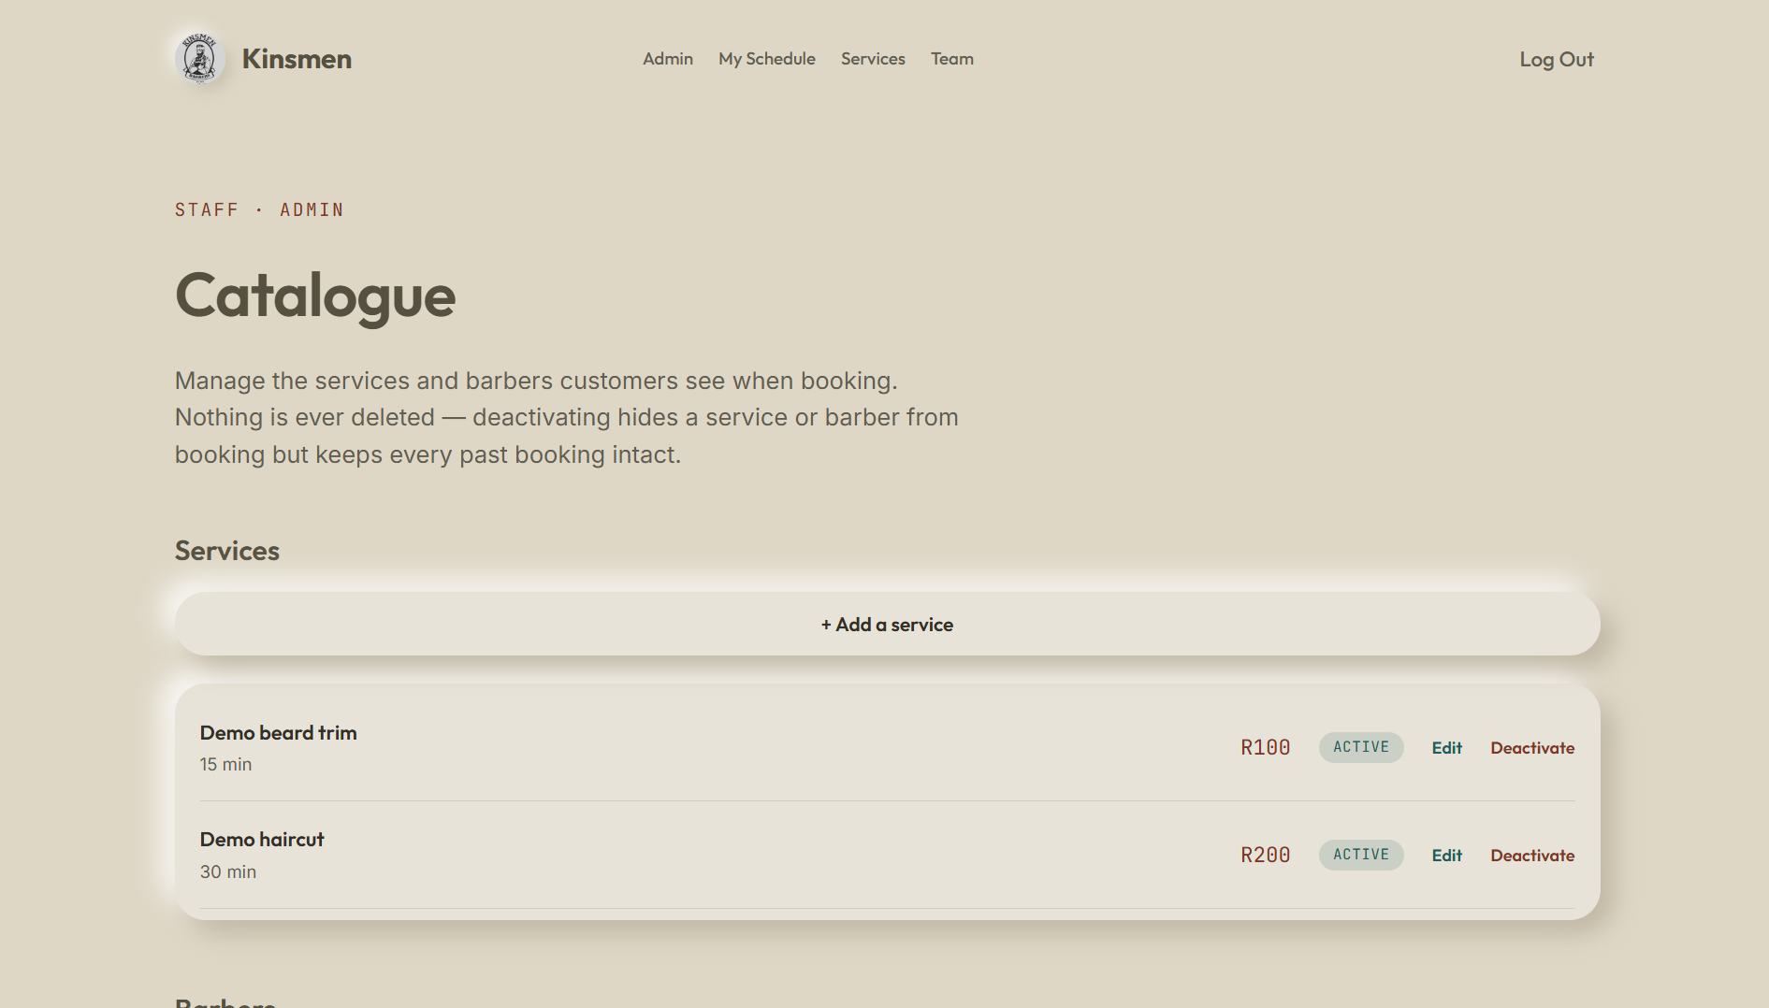
STAFF & ADMIN
Barber and admin tools
01
Barbers: own schedule, confirm / complete / no-show, block off time.
02
Admins: add, edit, deactivate services and barbers, working hours and barber skills.
03
Admins: grant Barber or Admin roles on a Staff accounts page, with an audit log.
KINSMEN · INSY7315 WIL · PART 2
05
Notes:
Barbers have their own view of their schedule, where they can confirm, complete, or mark a booking as a no-show, and block off time when they're unavailable. Admins manage the full catalogue — adding, editing or deactivating services and barbers, and setting working hours and barber skills. Admins can also grant Barber or Admin roles to staff accounts, and every role change is captured in an audit log.
[Presenter: Gregory]

Slide 6
SYSTEM DESIGN
Architecture
Browser
Kinsmen.Web
ASP.NET Core MVC · Render
Kinsmen.Api
ASP.NET Core · Render
GitHub + Actions
deploys to Render when checks pass
Auth0
sign-in
MongoDB Atlas
Cape Town
Brevo
emails
Auth0
token check
Browsers never call the API directly — the API enforces every rule.
KINSMEN · INSY7315 WIL · PART 2
06
Notes:
Here's how the system fits together. The browser talks to Kinsmen.Web, our ASP.NET Core MVC front end hosted on Render, which in turn talks to Kinsmen.Api, a separate ASP.NET Core service also on Render. For sign-in, the browser talks directly to Auth0. The API is the only part that talks to MongoDB Atlas in Cape Town, to Brevo for emails, and to Auth0 for token checks. GitHub Actions deploys to Render automatically once checks pass. The key point is that browsers never call the API directly — the API enforces every single rule.
[Presenter: Zario]

Slide 7
TECHNOLOGY
What changed since Part 1
PART 1 PLAN: SQL Server + Entity Framework · Azure · Custom accounts
PART 2 BUILD: MongoDB Atlas · Auth0 · Render (Docker) · Brevo · GitHub Actions — still C# / .NET 10
01
Why: free tiers, no stored passwords, multi-document transactions, Render's free tier blocks SMTP (hence Brevo's HTTPS API).
02
Design patterns actually used: dependency injection, repository abstraction, unit-of-work transactions.
Factory, Strategy and Observer from the Part 1 plan were not needed.
KINSMEN · INSY7315 WIL · PART 2
07
Notes:
Our original Part 1 plan was SQL Server with Entity Framework on Azure, with our own custom account system. For Part 2 we moved to MongoDB Atlas, Auth0 for authentication, Render with Docker for hosting, Brevo for email, and GitHub Actions for deployment — still built in C# on .NET 10 throughout. We made this change for a few concrete reasons: better free tiers, not storing passwords ourselves, MongoDB's multi-document transaction support, and because Render's free tier blocks outbound SMTP, which is why we use Brevo's HTTPS API instead. In the end we used dependency injection, repository abstraction and unit-of-work transactions; the Factory, Strategy and Observer patterns from our Part 1 plan weren't actually needed.
[Presenter: Kaehil]

Slide 8
BUSINESS LOGIC
Booking rules that protect the business
01
No double booking: transactions + a per-barber lock; concurrent requests retry safely.
Pending
02
Safe retries: an idempotency key means a repeated click never creates a second booking.
Cancelled
Confirmed
03
Prices calculated on the server; each booking keeps a price snapshot.
Completed /
No-show
04
Max 3 active bookings per customer; only qualified barbers are offered.
KINSMEN · INSY7315 WIL · PART 2
08
Notes:
A core requirement was that two customers can never book the same barber for overlapping times. We enforce this with database transactions and a per-barber lock, so concurrent requests retry safely instead of conflicting. We also use an idempotency key, so if a customer double-clicks 'book', it never creates a second booking by accident. Prices are always calculated on the server, and each booking keeps a snapshot of the price at the time it was made. Each customer can have at most three active bookings, and only barbers qualified for a given service are offered — and every booking moves through a clear lifecycle, from Pending to Confirmed to Completed or No-show, with cancellation possible from Pending or Confirmed.
[Presenter: Zario]

Slide 9
SECURITY
Defence in depth
01
Auth0 login; the API checks every token's signature, issuer, audience and expiry.
02
Role and ownership checks in the web app AND the API.
03
Rate limiting per visitor and per user; 429 with Retry-After.
04
Content Security Policy, anti-clickjacking headers, XSS fixes, no secrets in Git.
05
Staff changes: verified emails only, no self-promotion, admins can't be demoted in-app, audit log.
KINSMEN · INSY7315 WIL · PART 2
09
Notes:
We use Auth0 for login, and on every request our API checks the token's signature, issuer, audience and expiry — not just that a token exists. Role and ownership checks happen in both the web app and the API, so there's no single point of failure. We rate-limit requests per visitor and per logged-in user, returning a 429 status with a Retry-After header when limits are hit. We've also applied a Content Security Policy, anti-clickjacking headers, fixes for XSS issues we found, and we never commit secrets to Git. Staff role changes require a verified email, nobody can promote themselves, admins can't be demoted from inside the app, and every change is logged in an audit trail. As one concrete example from our own testing: our first rate limit was implemented per IP address, which meant every visitor behind our web server shared a single allowance — code review caught this, and limits now correctly follow each individual visitor.
[Presenter: Kyra]

Slide 10
QUALITY
Testing and quality
01
Docker images built and started with production settings in CI; CSP checked in a real browser.
REAL ISSUES FOUND BY REVIEW & TESTING
Shared rate limit
Stored XSS through names
Accidentally deleted setup scripts
Locale price-format bug
KINSMEN · INSY7315 WIL · PART 2
10
Notes:
In CI, we build the actual Docker images and start them with production settings before anything ships, and we check our Content Security Policy in a real browser rather than assuming it's correct. Reviewing and testing the system surfaced several real problems before they reached production: a shared rate limit, a stored XSS vulnerability through user-entered names, accidentally deleted setup scripts, and a locale-related price formatting bug. Catching these during development, rather than after deployment, is exactly what this process is for.
[Presenter: Kyra]

Slide 11
PROCESS
How we worked (DevOps)
Feature
branch
Pull
request
CI
build · scan · test · smoke
Review
1 approval req.
Merge
Auto deploy
to Render
Secrets live only in Render's dashboard.
LESSON LEARNED: branch protection was switched on mid-project, after a merge bypassed review.
KINSMEN · INSY7315 WIL · PART 2
11
Notes:
Our workflow starts with a feature branch, which becomes a pull request. From there, CI runs automatically — build, a vulnerability check, our test suite, and a Docker smoke test. A teammate then reviews the pull request; branch protection requires at least one approval and all checks passing before it can merge. Once merged, Render deploys automatically. All our secrets live only in Render's dashboard, never in the repository. One honest lesson learned: we only switched on branch protection partway through the project, after a merge slipped through without review — we've enforced it strictly ever since.
[Presenter: Kaehil]

Slide 12
THE TEAM
Team contributions
Team Member | Contribution
Zario | Booking API, MongoDB design, transactions, Atlas scripts, barber skills; reviewed and merged multiple PRs.
Gregory | MVC front end, barber schedule, role-based navigation, admin screens, landing page, accessibility work.
Kyra | Built Auth0 sign-up, login and logout with role checks, plus booking emails through Brevo and completed-visit reviews, all with tests.
Kaehil | Led the group and integration, and built the CI pipeline, Docker/Render deployment, the admin catalogue API, security hardening and staff management, while reviewing and merging most of the team's pull requests.
KINSMEN · INSY7315 WIL · PART 2
12
Notes:
This table summarises what each of us focused on. Zario led the booking API, MongoDB design, transactions and Atlas scripts, and reviewed/merged most pull requests. Gregory built the MVC front end, barber schedule, role-based navigation, admin screens and accessibility work. [Kyra's and Kaehil's summaries need to be completed/confirmed before this is finalised.] We all reviewed each other's work across boundaries, but this reflects where each of us spent most of our time.
[Presenter: everyone]

Slide 13
LOOKING AHEAD
Limitations & next steps
CURRENT LIMITS
NOT BUILT
NEXT STEPS
Free-tier sleep and ~1s latency (API in Frankfurt, database in Cape Town).
Demo prices/hours awaiting client sign-off; pending bookings don't expire yet.
Loyalty programme
Guest booking
Shop / POS
Per-barber profile pages
Client domain for email
Persist login keys
Move database region
KINSMEN · INSY7315 WIL · PART 2
13
Notes:
We want to be upfront about current limitations. Because we're on free hosting tiers, the system can sleep when idle, and there's roughly a one-second latency between our API in Frankfurt and our database in Cape Town. The prices and hours shown are demo data awaiting the client's sign-off, and pending bookings don't yet expire automatically. We haven't built a loyalty system, guest booking, a shop/POS feature, or per-barber profile pages — these were out of scope for Part 2. Looking ahead, our next steps are setting up a client domain for email, persisting login keys, and moving the database to a closer region to reduce that latency.
[Presenter: everyone]

Slide 14
Thank you
Questions?
kinsmen-web.onrender.com
github.com/Kaehil-I/kinsmen-barbershop
Kaehil · Kyra · Zario · Gregory
KINSMEN · INSY7315 WIL · PART 2
14
Notes:
Thank you for your time. Once again, the live site is at kinsmen-web.onrender.com, and the full source is on GitHub at github.com/Kaehil-I/kinsmen-barbershop. This was built by Kaehil, Kyra, Zario and Gregory — we're happy to take any questions.
[Presenter: Kaehil]

